Slide 1

Education on Understanding Korean Law
Mandatory education for International Student

Slide 2

Different laws in different cultures
South Korea ▷ ‘OK’
USA ▷ ‘OK’
Brazil ▷ ‘Gesture of insult’
Same behaviors, different reactions（results)!

Slide 3
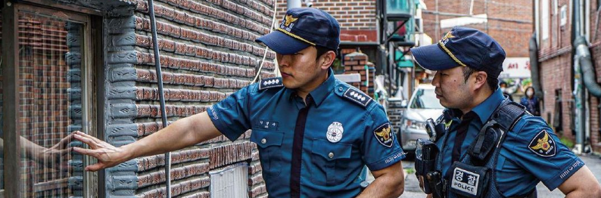
Contents
Sexual Crimes
Fraud
Drug Crimes
Gambling
Students Working
Part-time
Q&A

Slide 4

01.Sexual Crimes
▪Sexual Crime
▪Dating Violence & Stalking
Learn about what is sexual crime and
how to prevent & deal with it

Slide 5
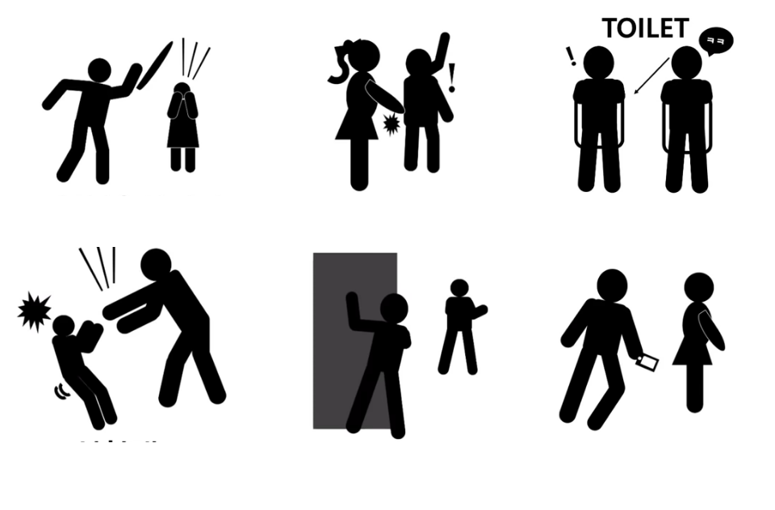
Sexual Crimes
⬥ Sexual violence :
- This means not only rape, sexual harassment, and sexual violence, but all violence done against the will of other people by sex.
「Criminal Law」Article #297~#305-3
Rape
Sexual molestation
Sexual harassment
Sexual abuse
Stalking
Cyber sexual violence

Slide 6
Sexual Crimes
1. Have a clear view of gender
2. Always pay attention to your surroundings
3. Make your expression clear as “Yes” or “No”
4. Express a clear refusal in an unpleasant or unwanted situation
5. Learn enough how to report and respond to any kind of situation
6. Sexual violence can occur through media such as the cell phone or computer, and even between lovers(dating abuse)
How to
prevent
sexual violence
1. Keep the evidence
- Record accurately the situation of the incident and go to the obstetrician-gynecologist wearing the same clothes you were wearing at the time of the incident
2. Ask for help around you
3. Better to report to the police as soon as possible
How to
respond & deal with
sexual violence

Slide 7
Sexual Crimes
⬥ How to report sexual violence
- Korean National Police Agency 112
- Emergency call for women 1366(24hours)
- Online report : https://www.safe182.go.kr

Slide 8
Dating Violence & Stalking
⬥ Dating violence :
- Acts of violence or threats by one partner against another in a relationship
⬥ Stalking :
- Acts that cause anxiety or fear, such as continuously or repeatedly approaching or watching the victim against the will of the victim without a justifiable reason

Slide 9

02.Fraud
▪Voice Phishing
▪Smishing
Learn about what is Voice Phishing and Smishing
how to deal with it

Slide 10
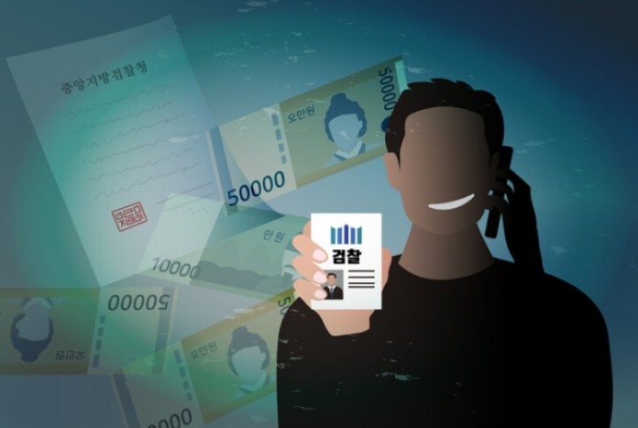
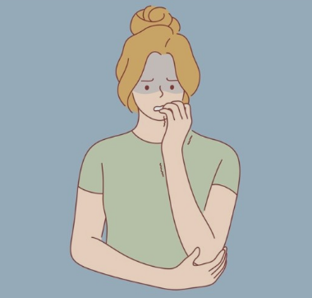
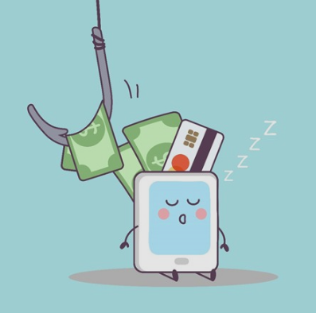
02-1 Voice Phishing
⬥ Voise Phishing :
- Voise Phishing is a financial scam via communication devices such as telephones, mobile phone, internet to obtain your money or financial info
Impersonation
Anxiety
Demand

Slide 11
02-1 Voice Phishing
○ When you get a call from unfamiliar number, do not answer
- If it is important, they will call you again or leave text messages
○ Remember that Goverment Agencies or Financial Services will never ask you for your money or banking info
How to
prevent
Voice Phishing
How to
deal with
if you get a Voice Phishing call
○ Immediately call the police(112)
- They will connect you with the financial crimes division, who can assist you with a Trasaction Cancellation Request

Slide 12
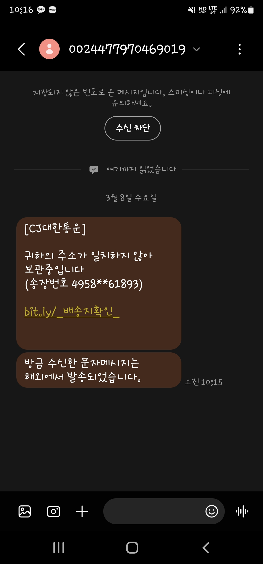
02-2 Smishing
⬥ Smishing :
- SMS+Phishing=Smishing
- Smishing is a form of phishing in which the attacker sends a compelling text message to trick the victim into clicking a link or installing a malicious app to steal their financial information.

Slide 13
02-1 Voice Phishing
○ To prevent smishing, strengthen the security settings of your mobile phone and make sure to check before clicking a URL even if the message is sent from someone you know.
How to prevent
Smishing

Slide 14
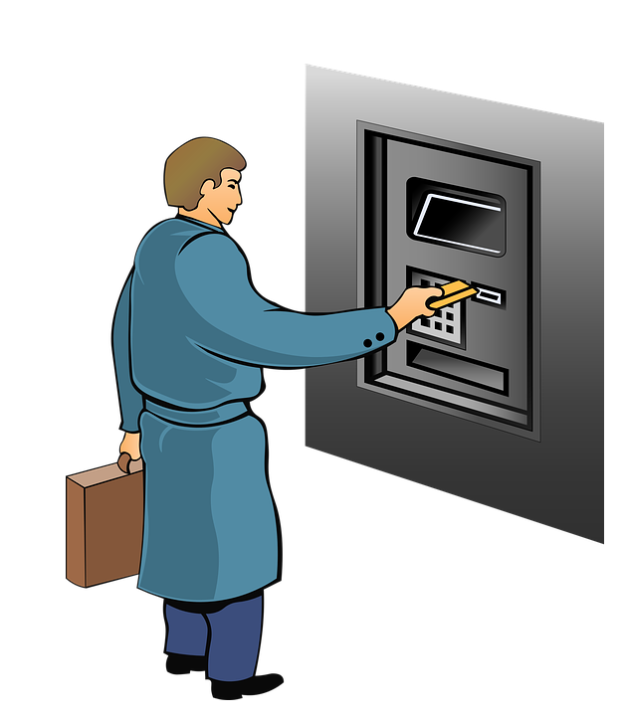


02-1 Voice Phishing Money Collector
Phishing organizations steal personal information after opening a fake job search site, and use job seekers as voice phishing money collectors
Fake job
(misleading job seekers with pharases like easy work, high salary, no need for facing customers)
△ Collecting accounts △ Collecting bonds
△ Collecting loans
△ Collecting cash
Aiding and abetting fraud

Slide 15
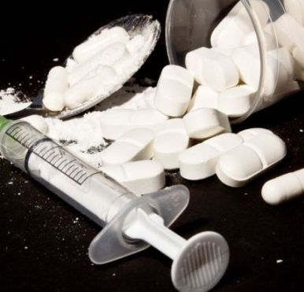
03.Drug Crimes

Slide 16
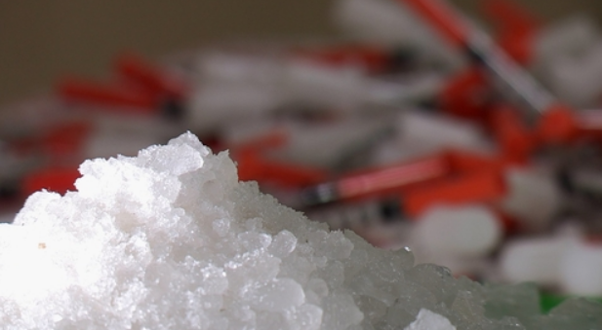
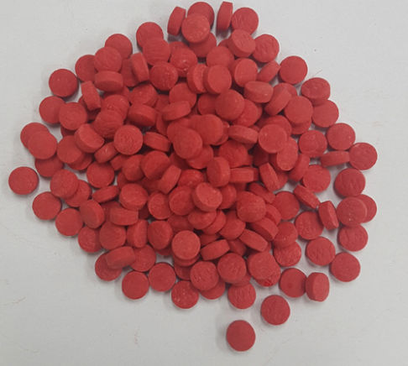
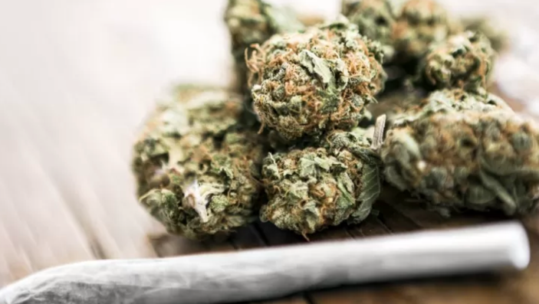
03. Drug Crimes
Methamphetmine
Yaba
Cannabis
Having drugs, antipsychotic drugs, and cannabis is illegal and is punishable as a crime. Drugs are not only had, sold, purchased, cultivated, sterilized, but also the fact of possessing drugs is a criminal.
Never possess or transport drugs!

Slide 17
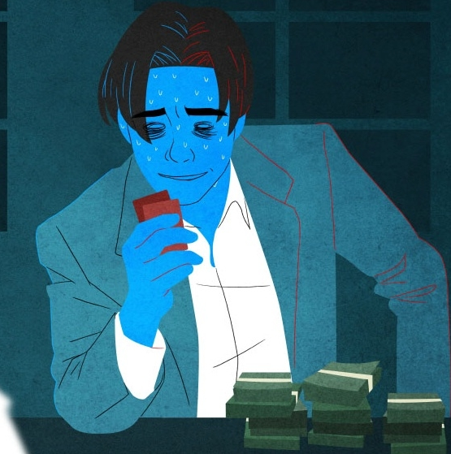
04.Gambling

Slide 18
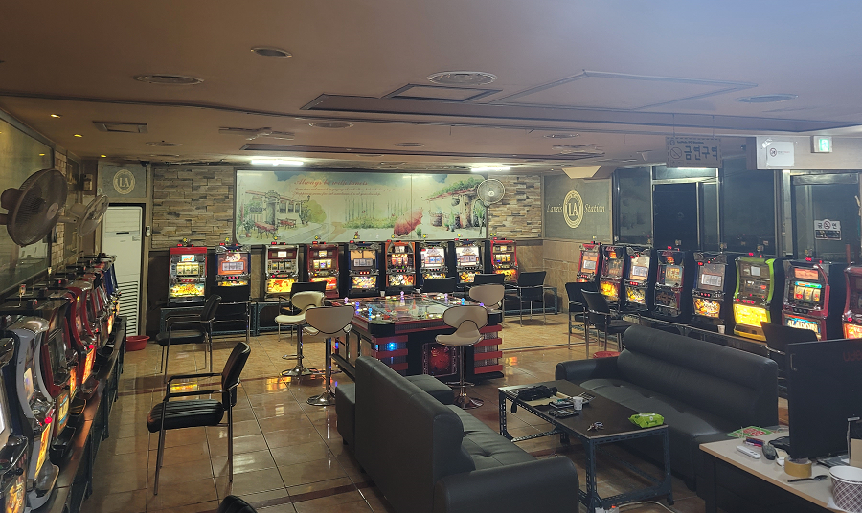
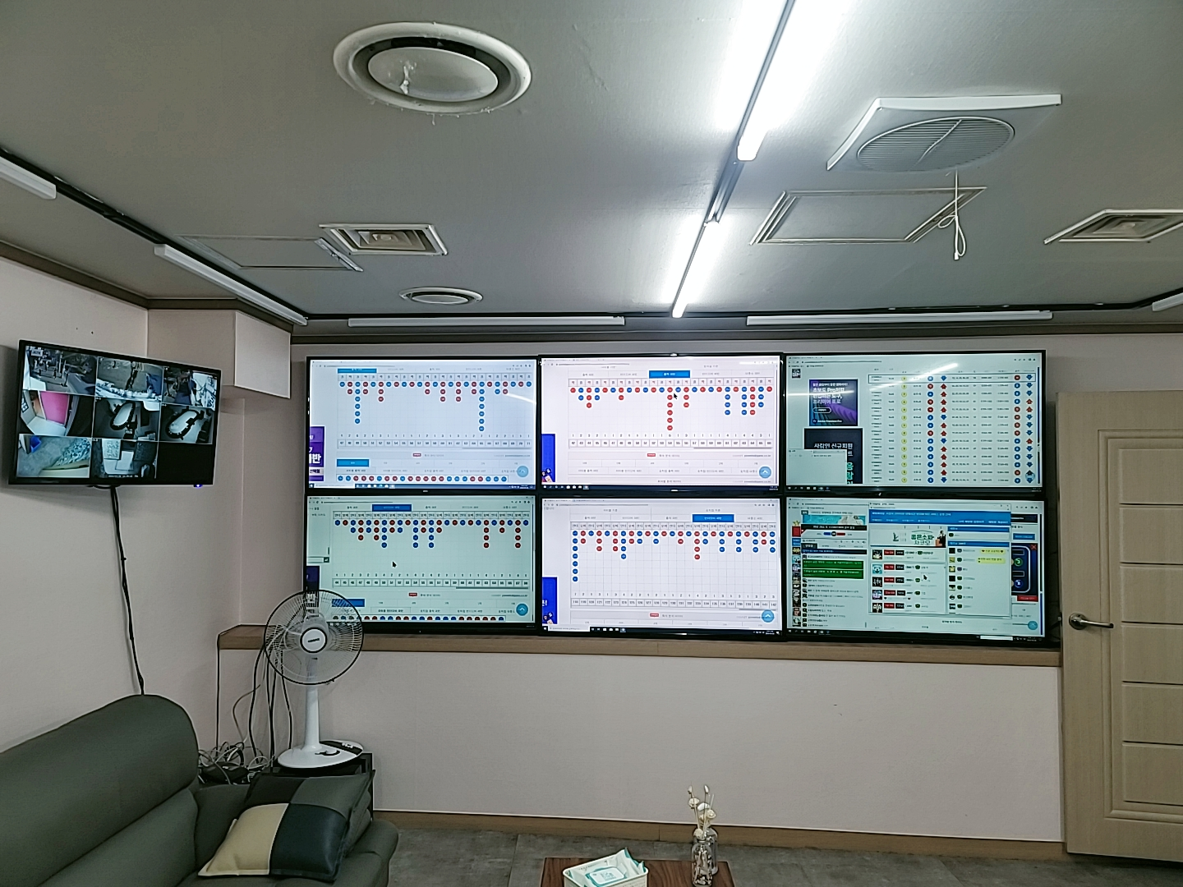
04. Gambling
Game center(Japanese slot-machines)
Powerball(American lottery)
In korea, all games for money and valuables are illegal and punishable by gambling charge.
Just providing a place to gamble is punishable by gabling charge as well

Slide 19

05.Students Working Part-time

Slide 20
05. Students Working Part-time
Activities outside the status of residence(Part-time work)
- You must apply for part-time work permission after obtaining the confirmation of the officer in charge of visa at university. However, all manufacturing and construction industries are restricted.
(Prohibitied entertainment industry, Private tutoring, etc.)
- Undergraduate students: within 20 hours per a week
- Graduate(Masters,Ph.D.) students: within 30 hours per a week
- However, only available when 70% of the semester has been completed and an average of B credits or more has been obtained, during the enrollment period

Slide 21
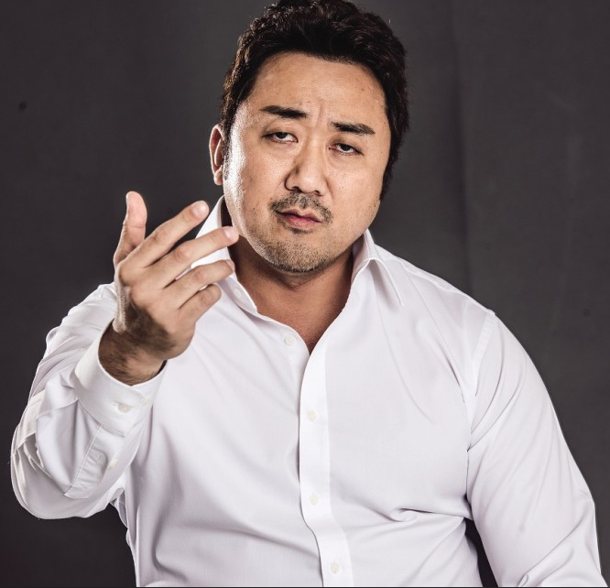
06.Q&A

Slide 22
Foreign Crime Victims Support Council
Guro Police Spdtation(Foreign Affairs Section) operates
Foreign Crime Victims Support Council(외국인범죄피해자지원협의체）
We provide
- Legal support
- Economic support
- Interpreter service
Don’t be hasitated and feel free to visit us
Thank you!

