Slide 1

Education on Understanding sexual violence
NOV. 29, 2024

Slide 2
To avoid becoimg a victim of sexual violence, one should not dress provocatively.
Is it true? Or not?

Slide 3
The preconceived notion contained in this remark is, "Is sexual assault the cause of sexual violence?"

Slide 4
Consent?(dictionary meaning)
grant permission to do what is requested.

Slide 5
Going into someone's house without permission? The crime of breaking into a house
Taking other people's things without permission? theft

Slide 6
Unauthorized Content Use?
Copyright Infringement
What about unauthorized sexual contact?
Sexual violence

Slide 7
Sexual violence :
- This means not only rape, sexual harassment, and sexual
violence, but all violence done against the will of other
people by sex.
Sexual violence refers to all forms of sexual activity
performed without the consent of the other people.

Slide 8
The concept of consent:
consent should always be clear, voluntary, and free from
coercion or pressure.

Slide 9
If consent is not established, consent is impossible under
drinking, medication, or psychological atrophy.
Minors do not have consent.

Slide 10
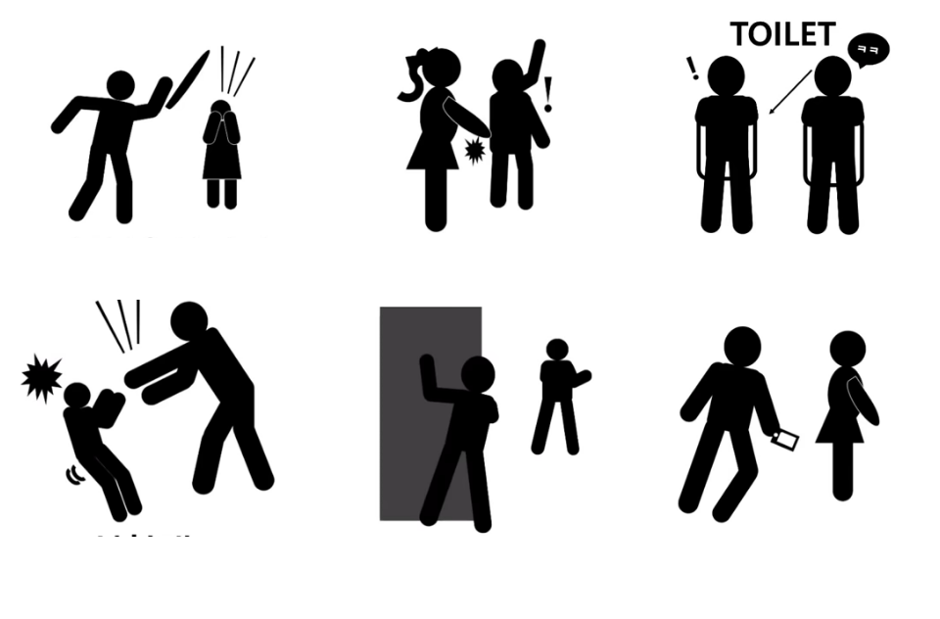

Slide 11
2. Types of sexual violence
Example include Rape, Sexual molestation, Sexual
harassment in toilet, Sexual abuse, Stalking, Cyber sexual
violence.

Slide 12
Among them, cyber sexual violence has been on the rise
recently.

Slide 13
Causes of the Increase in Digital Sexual Crimes
Anonymity of Technology: Perpetrators can easily hide their identities.

Slide 14
2. Rapid Spread: Content can quickly go viral through the internet and social media.
3. Lack of Legal and Social Awareness: Many people fail to fully grasp the severity of digital sexual crimes.

Slide 15
How to prevent sexual violence
1. Understanding Consent
2. Teaching Healthy Relationships
3. Recognizing Warning Signs

Slide 16
4. Bystander Intervention
5. Supporting Survivors
6. Raising Awareness

Slide 17
How to respond & deal with sexual violence
1. Believe the Survivor
2. Listen Without Judgment
3. Respect Their Choices
4. Offer Help

Slide 18
5. Encourage Professional Support
6. Maintain Privacy
7. Report if Necessary

Slide 19
How to report sexual violence
Korean National Police Agency 112
Emergency call for women 1366(24hours)
Online report : https://www.safe182.go.kr

Slide 20
definition of dating violence
★ Dating violence is physical and psychological
violence in a relationship.

Slide 21
Stalking
Acts that cause anxiety or fear, such as continuously or
repeatedly approaching or watching the victim against the will of the victim without a justifiable reason.

Slide 22
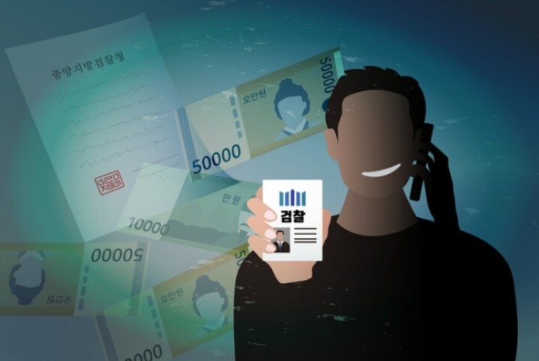
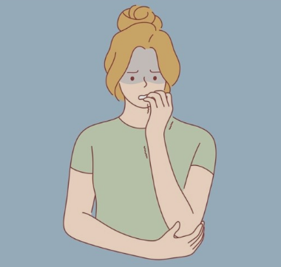

Voice phshing
Voice Phishing is a financial scam via communication devices such as telephones, mobile phone, internet to obtain your money or financial info.

Slide 23
How to prevent voice phishing
When you get a call unfamiliar number, do not answer.
If it is important, they will call you again and text massage.
Rember that goverment agencies or financial services will naver ask you for your money or
Banking info.

Slide 24
How to deal with if you get a call voice phishing?
Immediately call the police(112)
They will connet you with the financial crimes division, who can assist you with a Trasaction Cancellation Request

Slide 25
Foreign Crime Victims Support Council
Guro Police Spdtation ( Foreign Affairs Section) operates.
Foreign Crime Victims Support Council
(외국인범죄피해자 지원협의체)

Slide 26


