Slide 1

Education on Understanding Korean Law
＆
Prevention Sexual Crime

Slide 2
Contents
1. Knife(weapon) Crimes
2. Drug Crimes
3. Sexual Crimes

Slide 3

1. Knife(weapon) Crimes

Slide 4
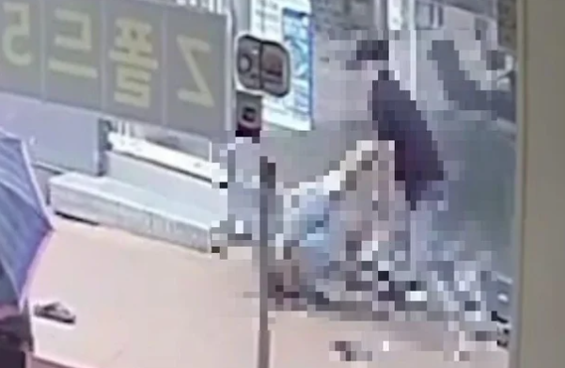
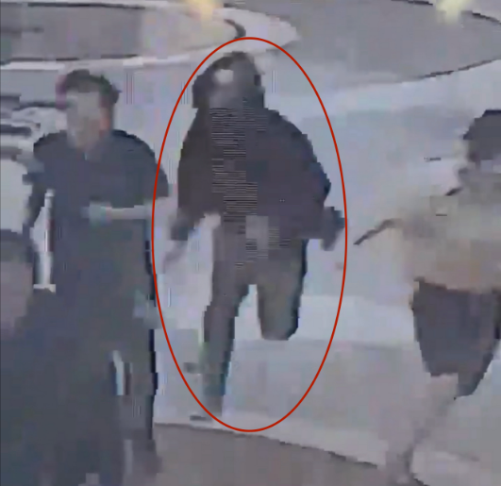
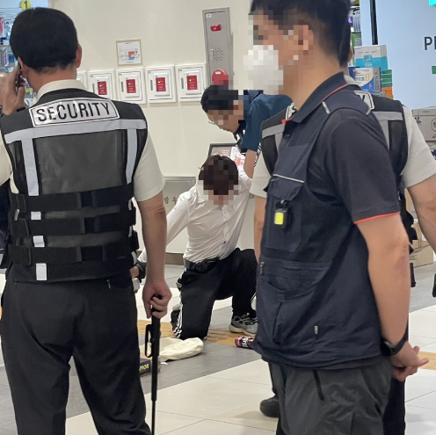
Knife crimes
happen in 2023
Sillimdong
２０２３.７.２１
Seohyun Station
２０２３.８.３
Express Bus Terminal Station
２０２３.８.４
etc...

Slide 5
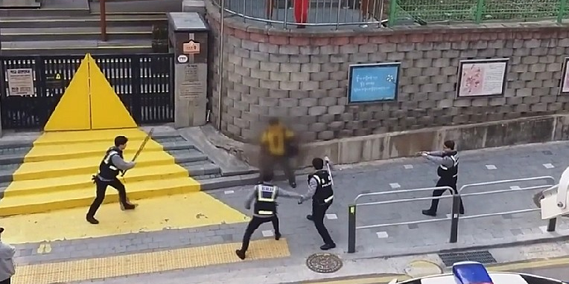


※ Caution
Confrontation
Self-defense
Possesion of Dangerous object(weapon)

Slide 6

2. Drug Crimes

Slide 7
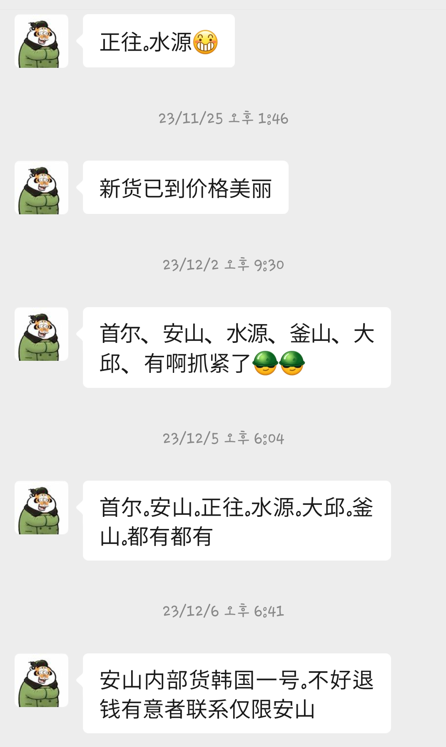
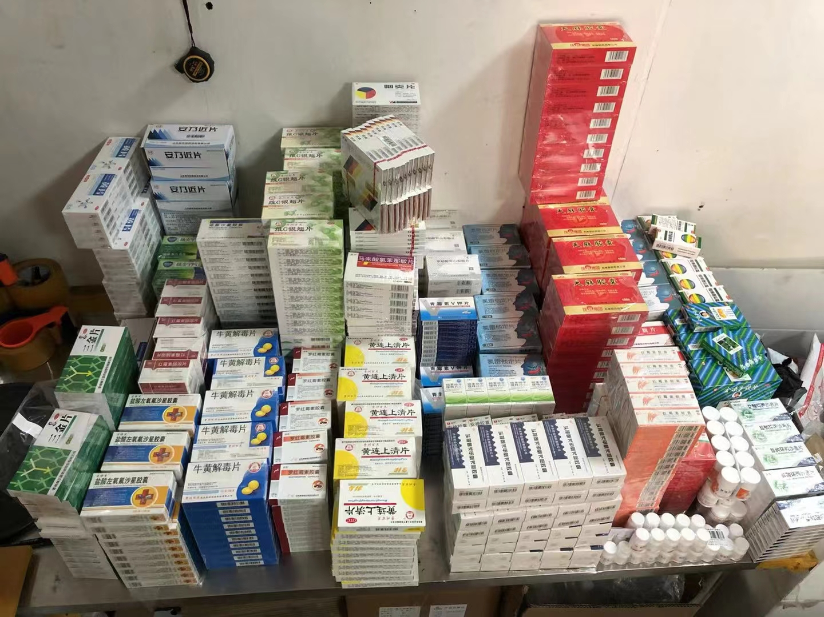
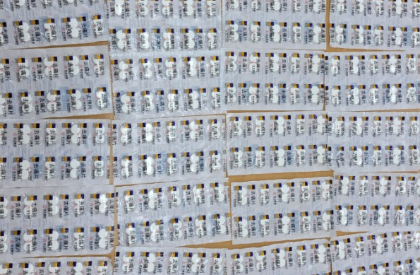
Drug dealer around us
Chatting with a chinese drug dealer
Chinese medicine selling in Korea
Chinese painkileer
= drug

Slide 8

3. Sexual Crimes

Slide 9
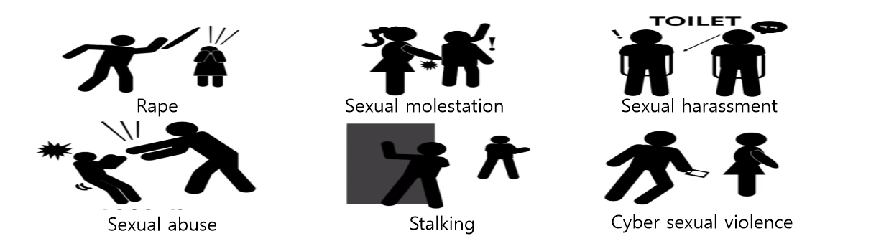
Sexual violence
This means not only rape, sexual harassment, and sexual violence, but all violence done against the will of other people by sex.

Slide 10

Digital sexual crimes
Using digital devices such as cameras to film the other person’s body without their consent
And all crimes using the footage such as
Illegal filming
Spreading
Production
Possession
Threat
Distribution

Slide 11


Call 112
for prompt assistance if you have witnessed or are the victim of a crime
Interpretation
is provided when reporting a crime(damage) and in order to assist foreiners who are not fluent in Korean

Slide 12


